Slide 1
Lec 1
Cloud Computing
What is Cloud Computing?
Why Cloud Computing?
Advantages and Disadvantages of Cloud Computing
NIST 5 Essential Characteristics of Cloud Computing

Slide 2
In 1961 computer scientist John McCarthy said:
“If computers of the kind I have advocated become the computers of the future, then computing may someday be organized as a public utility just as the telephone system is a public utility… Th computer utility could become the basis of a new and important industry.”

Slide 3
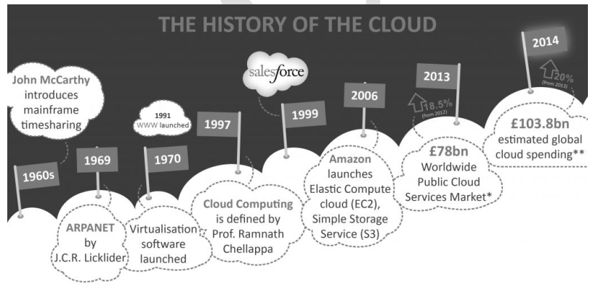
According to latest report Public Cloud services and infrastructure market Revenues reached $126 billion in Q1 2022, a 26 per cent jump from Q1 2021

Slide 4
What is cloud Computing?
Cloud computing is the delivery of computing services—including servers, storage, databases, networking, software, analytics, and intelligence—over the Internet (“the cloud”) and on a pay-as-you-go basis.

Slide 5
So How is the cloud different from the traditional client-server model of the Internet?

Slide 6
cloud vs traditional client-server model
The Internet has always been made up of servers, clients, and the infrastructure that connects them
Clients make requests of servers, and servers send responses
Cloud computing differs from this model in that cloud servers aren't just responding to requests — they're running programs and storing data on the client's behalf.

Slide 7
How does cloud computing work?
Rather than owning their own computing infrastructure or data centers, companies can rent access to anything from applications to storage from a cloud service provider
They can avoid the upfront cost and complexity of owning and maintaining their own IT infrastructure, and instead simply pay for what they use, when they use it.
In turn, providers of cloud-computing services can benefit from significant economies of scale by delivering the same services to a wide range of customers.

Slide 8
Examples of cloud computing
Consumer services like Gmail or the cloud backup of the photos on your smartphone , OneDrive etc
Some large enterprises host all their data and run all of their applications in the cloud.
For example, Netflix relies on cloud-computing services to run its video-streaming service and its other business systems, too.

Slide 9
Cloud computing is not just for organizations and businesses
it’s also useful for the average person as well
It enables us to run software programs without installing them on our computers
it enables us to store and access our multimedia content via the internet
it enables us to develop and test programs without necessarily having servers and so on
Cloud computing is a 21st-century marvel that holds its importance in almost every field you can think of.

Slide 10
Advantages of cloud computing
Cost
Cloud computing eliminates the capital expense of buying hardware and software and setting up and running on-site datacenters—the racks of servers, the round-the-clock electricity for power and cooling, and the IT experts for managing the infrastructure.

Slide 11
Speed
Most cloud computing services are provided self service and on demand, so even vast amounts of computing resources can be provisioned in minutes, typically with just a few mouse clicks, giving businesses a lot of flexibility and taking the pressure off capacity planning.
Global scale
The benefits of cloud computing services include the ability to scale elastically. That means delivering the right amount of IT resources—for example, more or less computing power, storage, bandwidth—right when they’re needed, and from the right geographic location.

Slide 12
Productivity
On-site datacenters typically require a lot of “racking and stacking”—hardware setup, software patching, and other time-consuming IT management chores. Cloud computing removes the need for many of these tasks, so IT teams can spend time on achieving more important business goals.
Reliability
Cloud computing makes data backup, disaster recovery, and business continuity easier and less expensive because data can be mirrored at multiple redundant sites on the cloud provider’s network.

Slide 13
disadvantages of cloud computing?

Slide 14
disadvantages of cloud computing
Cloud computing is not necessarily cheaper than other forms of computing, just as renting is not always cheaper than buying in the long term
If an application has a regular and predictable requirement for computing services it may be more economical to provide that service in-house
Some companies may be reluctant to host sensitive data in a service that is also used by rivals
And of course, you can only access your applications if you have an internet connection.

Slide 15
Even the largest and most technologically advanced companies can be vulnerable to being hacked.
Case in point is the pioneering electric car company, Tesla, owned by tech billionaire Elon Musk.
An unidentified hacker or hackers broke into a Tesla-owned Amazon cloud account and used it to “mine” cryptocurrency , Monero
Who knows when; who knows for how long.

Slide 16
Geography and Cloud Computing
Geopolitics is forcing significant changes on cloud-computing users and vendors
Firstly, there is the issue of latency: if the application is coming from a data center on the other side of the planet, or on the other side of a congested network, then you might find it sluggish compared to a local connection
Secondly, there is the issue of Data sovereignty
Data sovereignty is the concept that information which has been converted and stored in binary digital form is subject to the laws of the country in which it is located

Slide 17
Many companies, particularly in Europe, have to worry about where their data is being processed and stored
European companies are worried that, for example, if their customer data is being stored in data centers in the US or (owned by US companies), it could be accessed by US law enforcement
As a result, the big cloud vendors have been building out a regional data center network so that organizations can keep their data in their own region.

Slide 18
Cloud-computing region? availability zone?
Cloud-computing services are operated from giant datacenters around the world
Cloud service vendors often divides these datacenters by 'regions' and 'availability zones‘
Each region is a separate geographic area, like EU (London) or US West (Oregon), which then further subdivides into what it calls availability zones (AZs)

Slide 19
Cloud-computing region? availability zone?
An AZ is composed of one or more datacenters that are far enough apart that in theory a single disaster won't take both offline, but close enough together for business continuity applications that require rapid failover
Each AZ has multiple internet connections and power connections to multiple grids

Slide 20
Cloud computing model NIST
According to the National Institute of Standards and Technologies (NIST)
cloud computing is a model for enabling ubiquitous, convenient, on-demand network access to a shared pool of configurable computing resources (networks, servers, storage, applications, and services) that can be rapidly provisioned and released with minimal management effort or service provider interaction

Slide 21
This cloud model is composed of five essential characteristics:
On-demand self-service
Resource pooling
Rapid elasticity
Measured Service
Broad network access

Slide 22
On-demand self-service: Users are able to provision cloud computing resources without requiring human interaction, mostly done though a web-based self-service portal
Resource pooling: Service multiple customers from the same physical resources, by securely separating the resources on logical level.
Rapid elasticity: Resources are provisioned and released on-demand and/or automated based on triggers or parameters. This will make sure your application will have exactly the capacity it needs at any point of time. To the consumer, the capabilities available for provisioning often appear to be unlimited and can be appropriated in any quantity at any time

Slide 23
Measured service: Resource usage are monitored, measured, and reported (billed) transparently based on utilization. In short, pay per use.
Broad network access: Capabilities are available over the network and accessed through standard mechanisms that promote use by heterogeneous thin or thick client platforms (e.g., mobile phones, tablets, laptops, and workstations).

